Slide 1



Face image emotion recognition
based on CNN
Member：卢思宇、朱彦同、邵弈宁、孙康乐

Slide 2
1、Background and significance
Catalogue
2、Thoughts and methods
3、Specific steps
4、Research achievement

Slide 3



①
Background and significance

Slide 4



Background and significance
Expression recognition refers to the selection of expression states from still photos or video sequences to determine the emotional and psychological changes of the character. Can a computer accomplish a similar task? The answer is yes, but it needs to be trained to recognize emotions.

Slide 5

②
Thoughts and methods

Slide 6

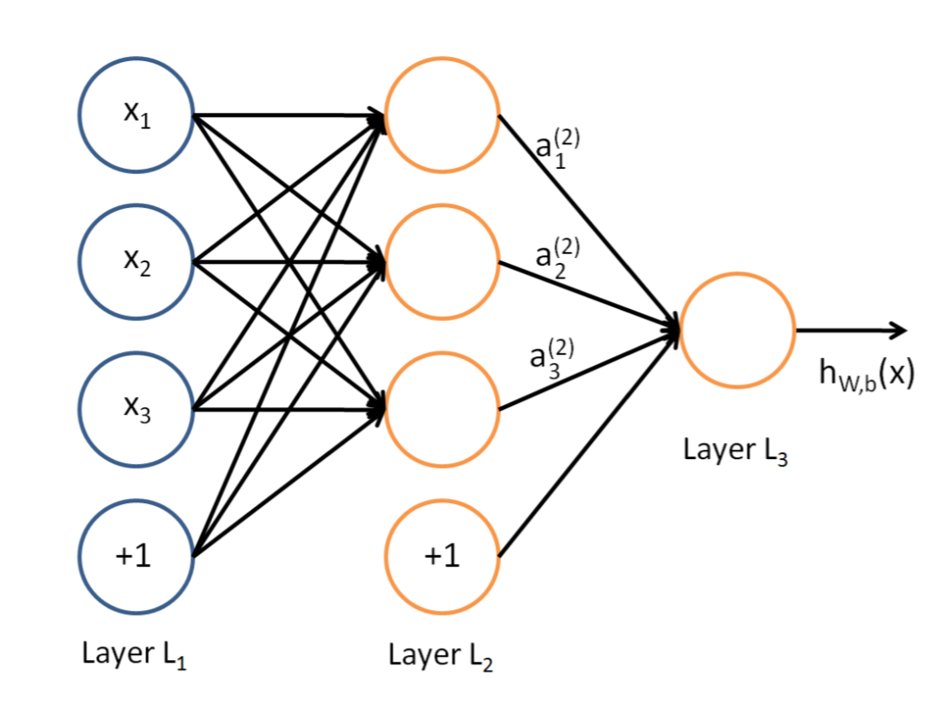
Thoughts and methods
Convolutional neural network (CNN) is one of the representative algorithms of deep learning, which has the characteristics of representational learning and shift-invariant classification. In face emotion recognition, the advantages of CNN include efficient feature extraction, strong adaptability and high accuracy. It can handle images of various sizes and resolutions, and has a certain degree of robustness to light, Angle and background changes. Some lightweight CNN models can also realize real-time face emotion recognition, which is suitable for rapid response scenarios such as video surveillance and facial recognition access control. In addition, the CNN model can further improve the performance of emotion recognition by adjusting the network structure, increasing the amount of data or introducing transfer learning.

Slide 7

③
Specific steps

Slide 8
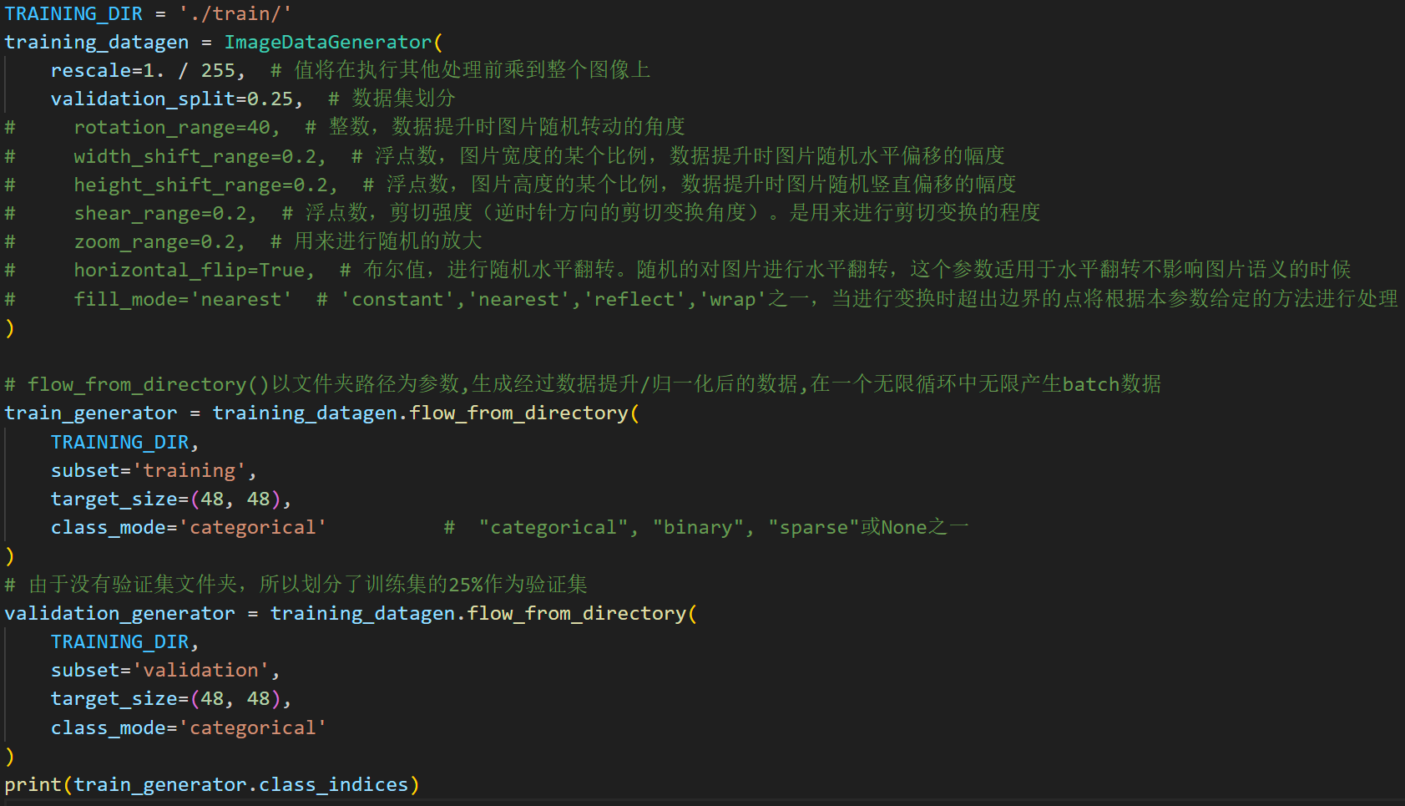
Image processing
Image data enhancement using the ImageDataGenerator class in Keras. First, the training datagen is defined to include operations such as scaling, rotating, offsetting, clipping, zooming, and random horizontal flipping. Then, the data is read from the training directory and the image size is set to 48x48 pixels, using the multi-class classification mode. An index for each category is printed. The verification set is automatically allocated by 25% of the training set.

Slide 9
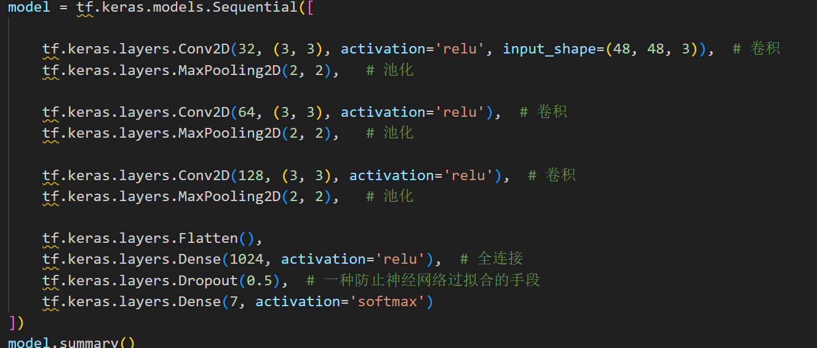
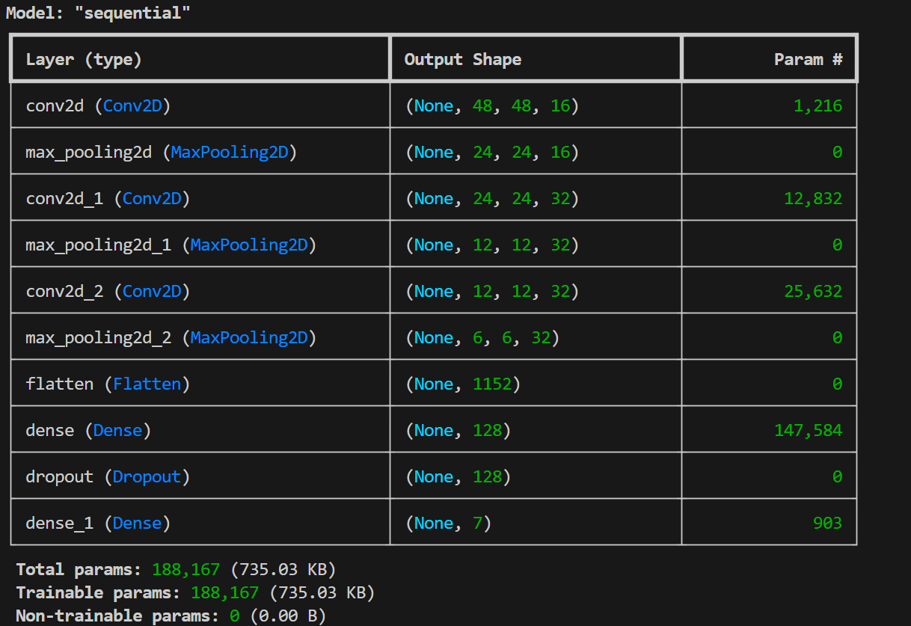
Model construction
This is a model structure diagram showing the type of each layer (such as conv2d, max_pooling2d, and so on), the number of parameters, and the output shape.
This code defines a Keras model with multiple convolution layers, pooling layers, fully connected layers, and discard layers. The convolution layer extracts the local features of the image, the pooling layer reduces the size of the feature map, the fully connected layer integrates the features and classifies them, and the discarded layer prevents overfitting. The final fully connected layer has 7 neurons and uses softmax activation function output for multi-class classification.

Slide 10

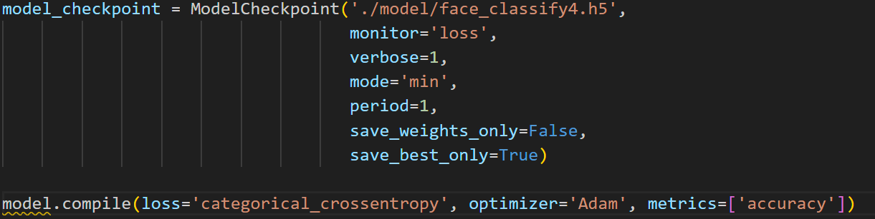
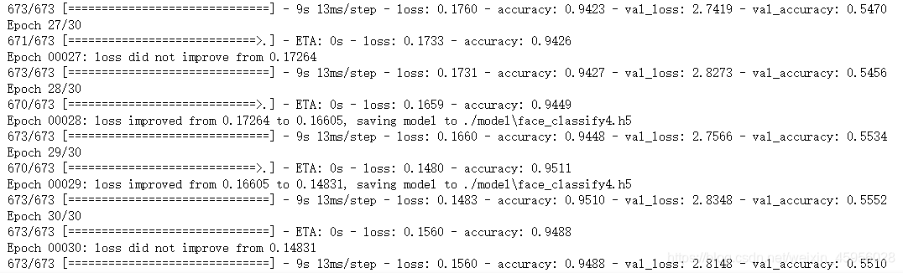
Model training
Training result

Slide 11
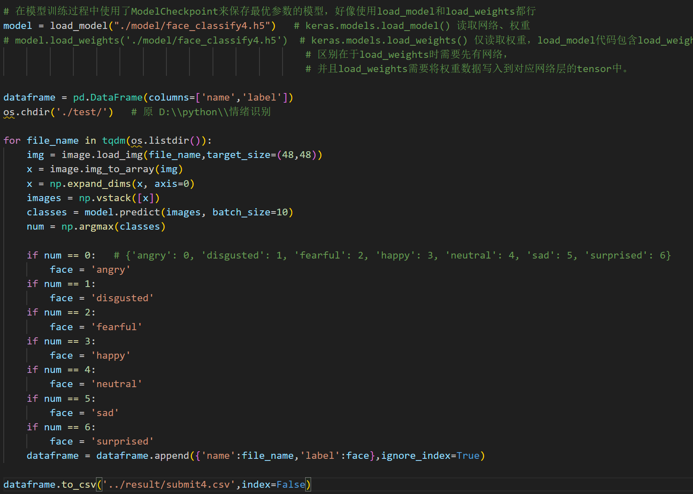
Use models to make predictions

Slide 12
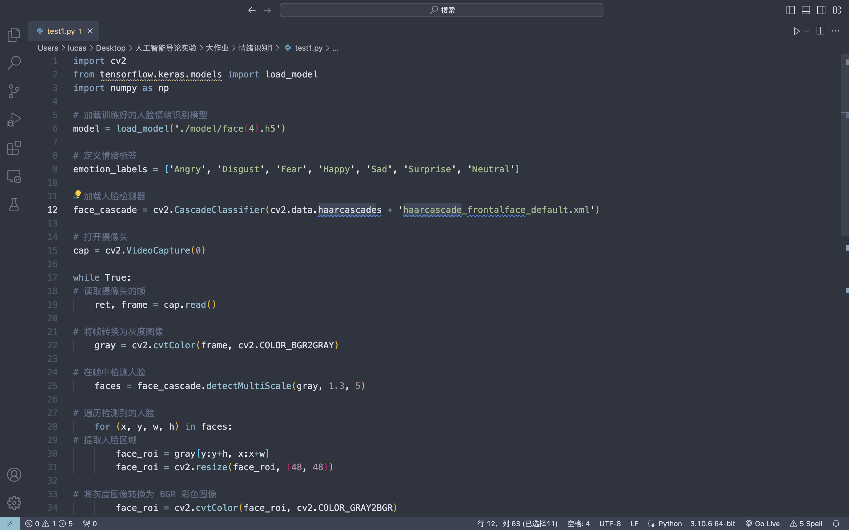
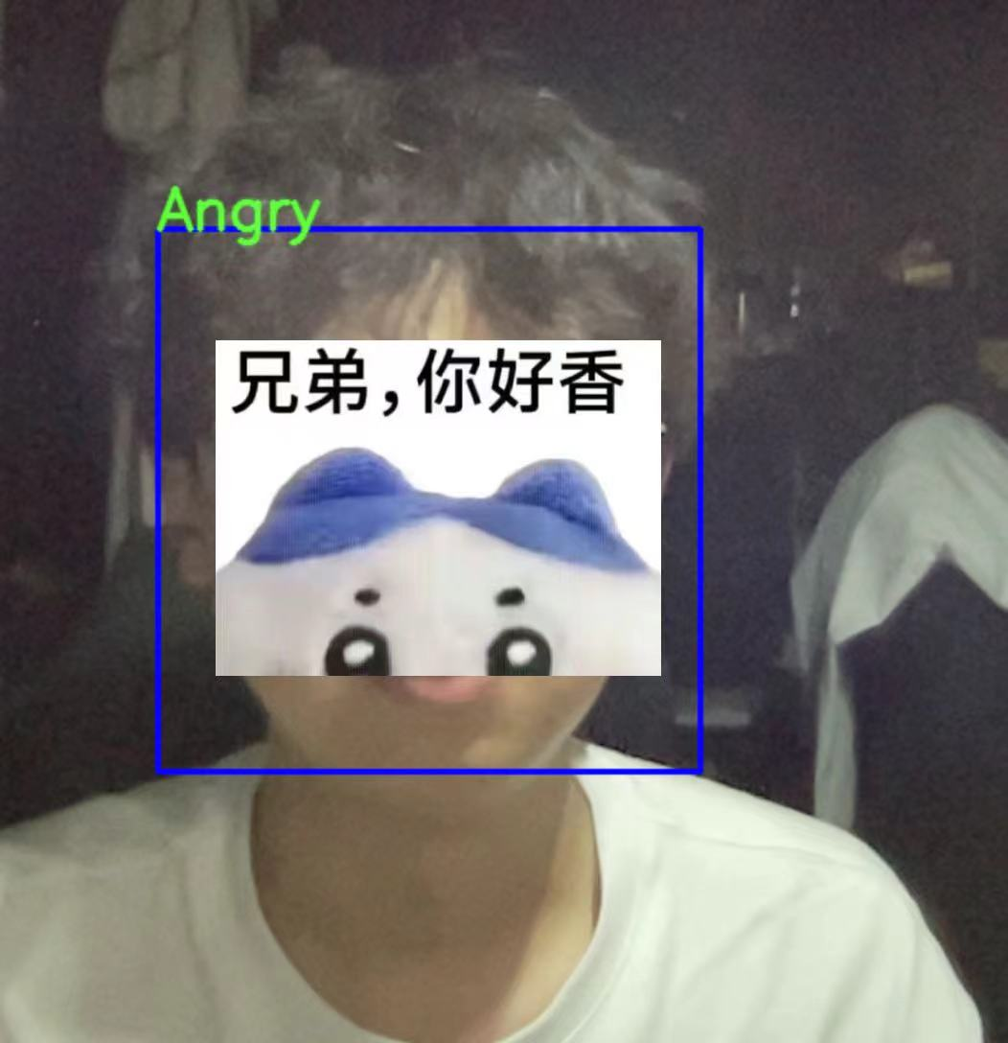
Real-time recognition of facial emotions in camera frames

Slide 13
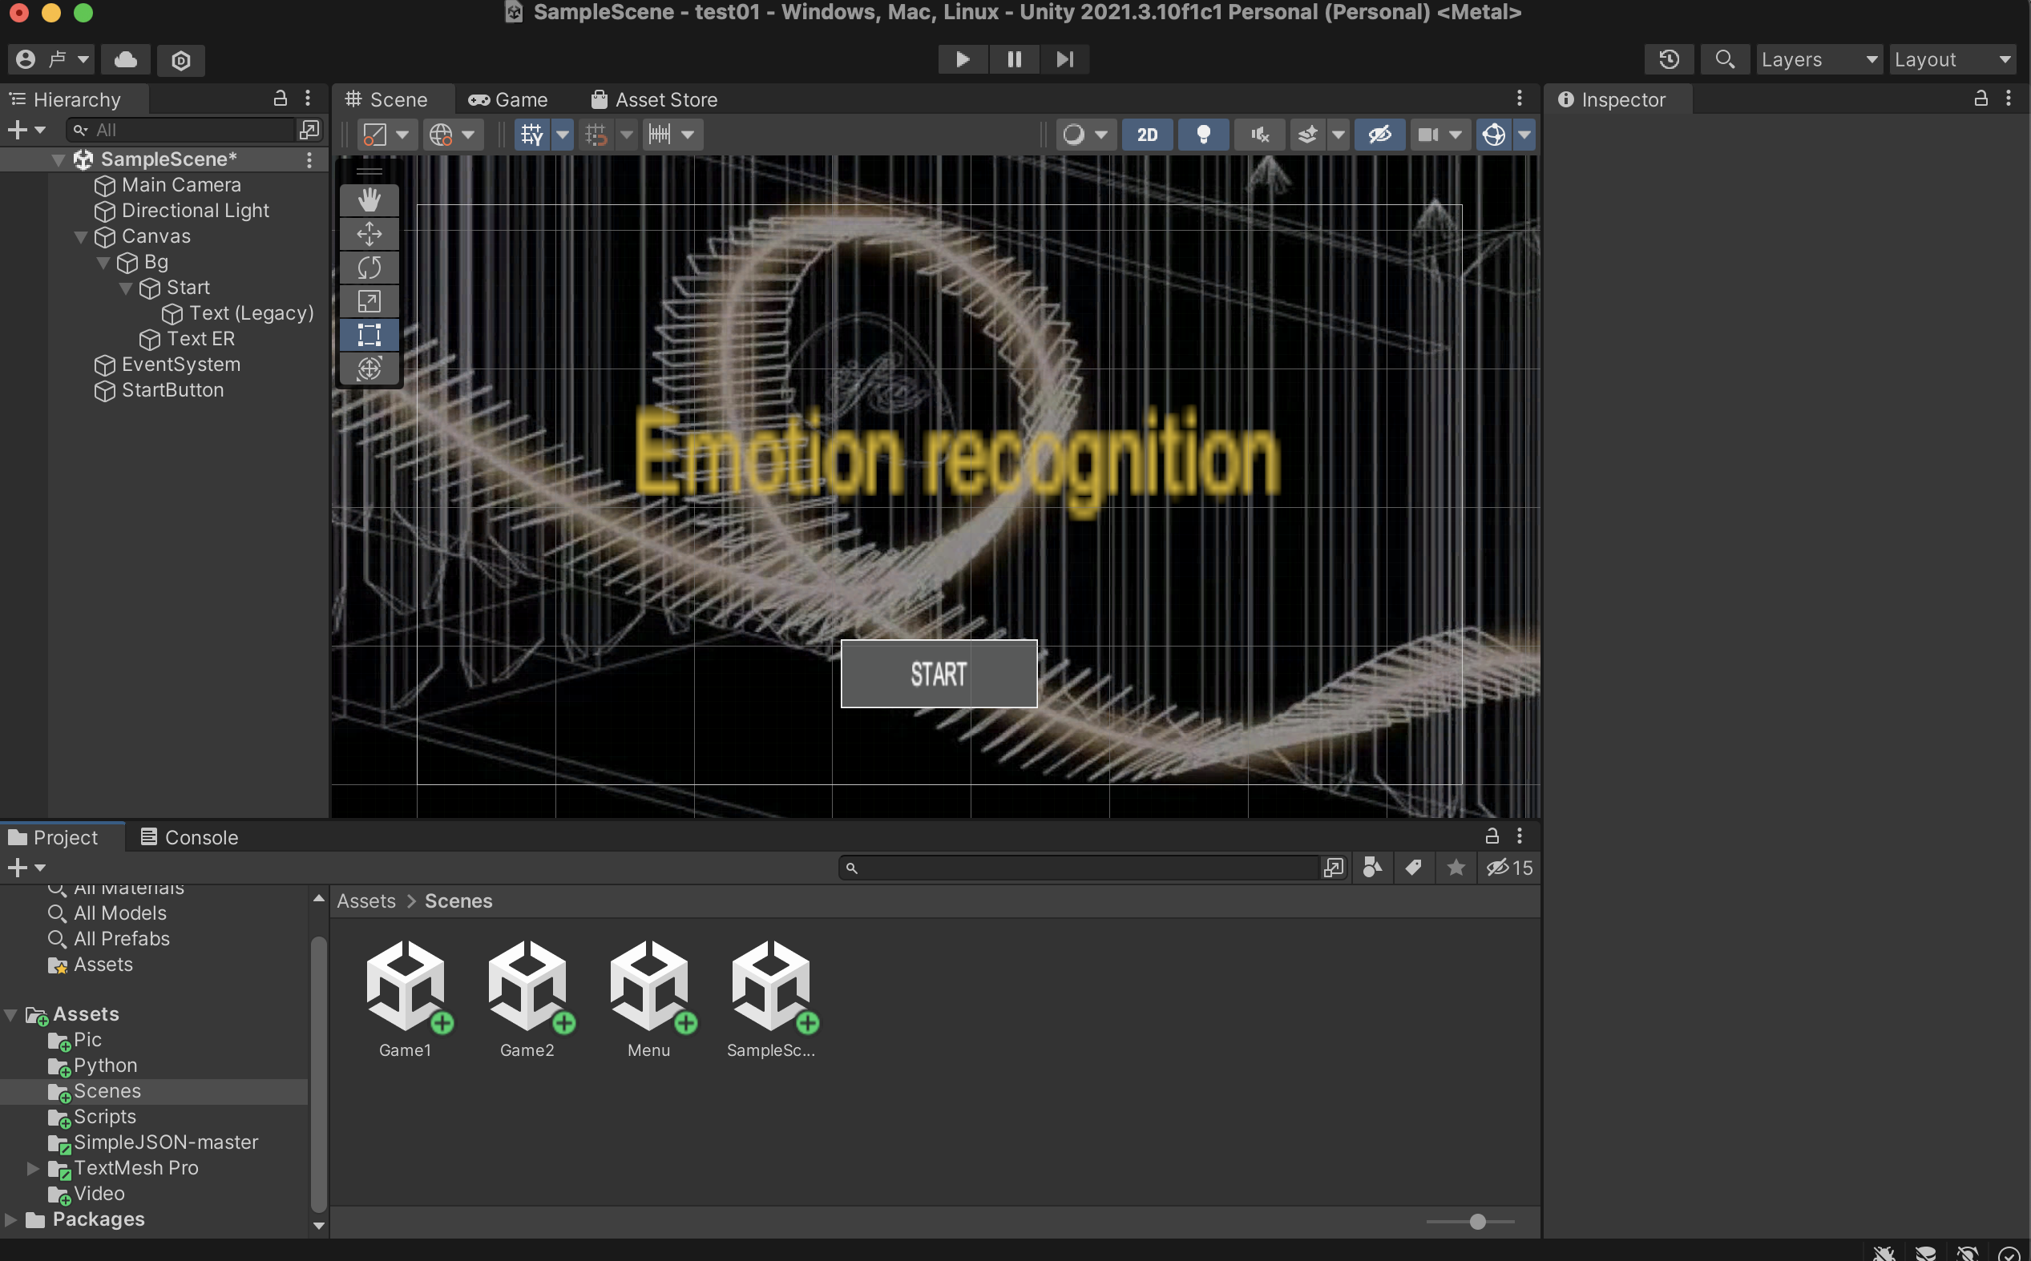
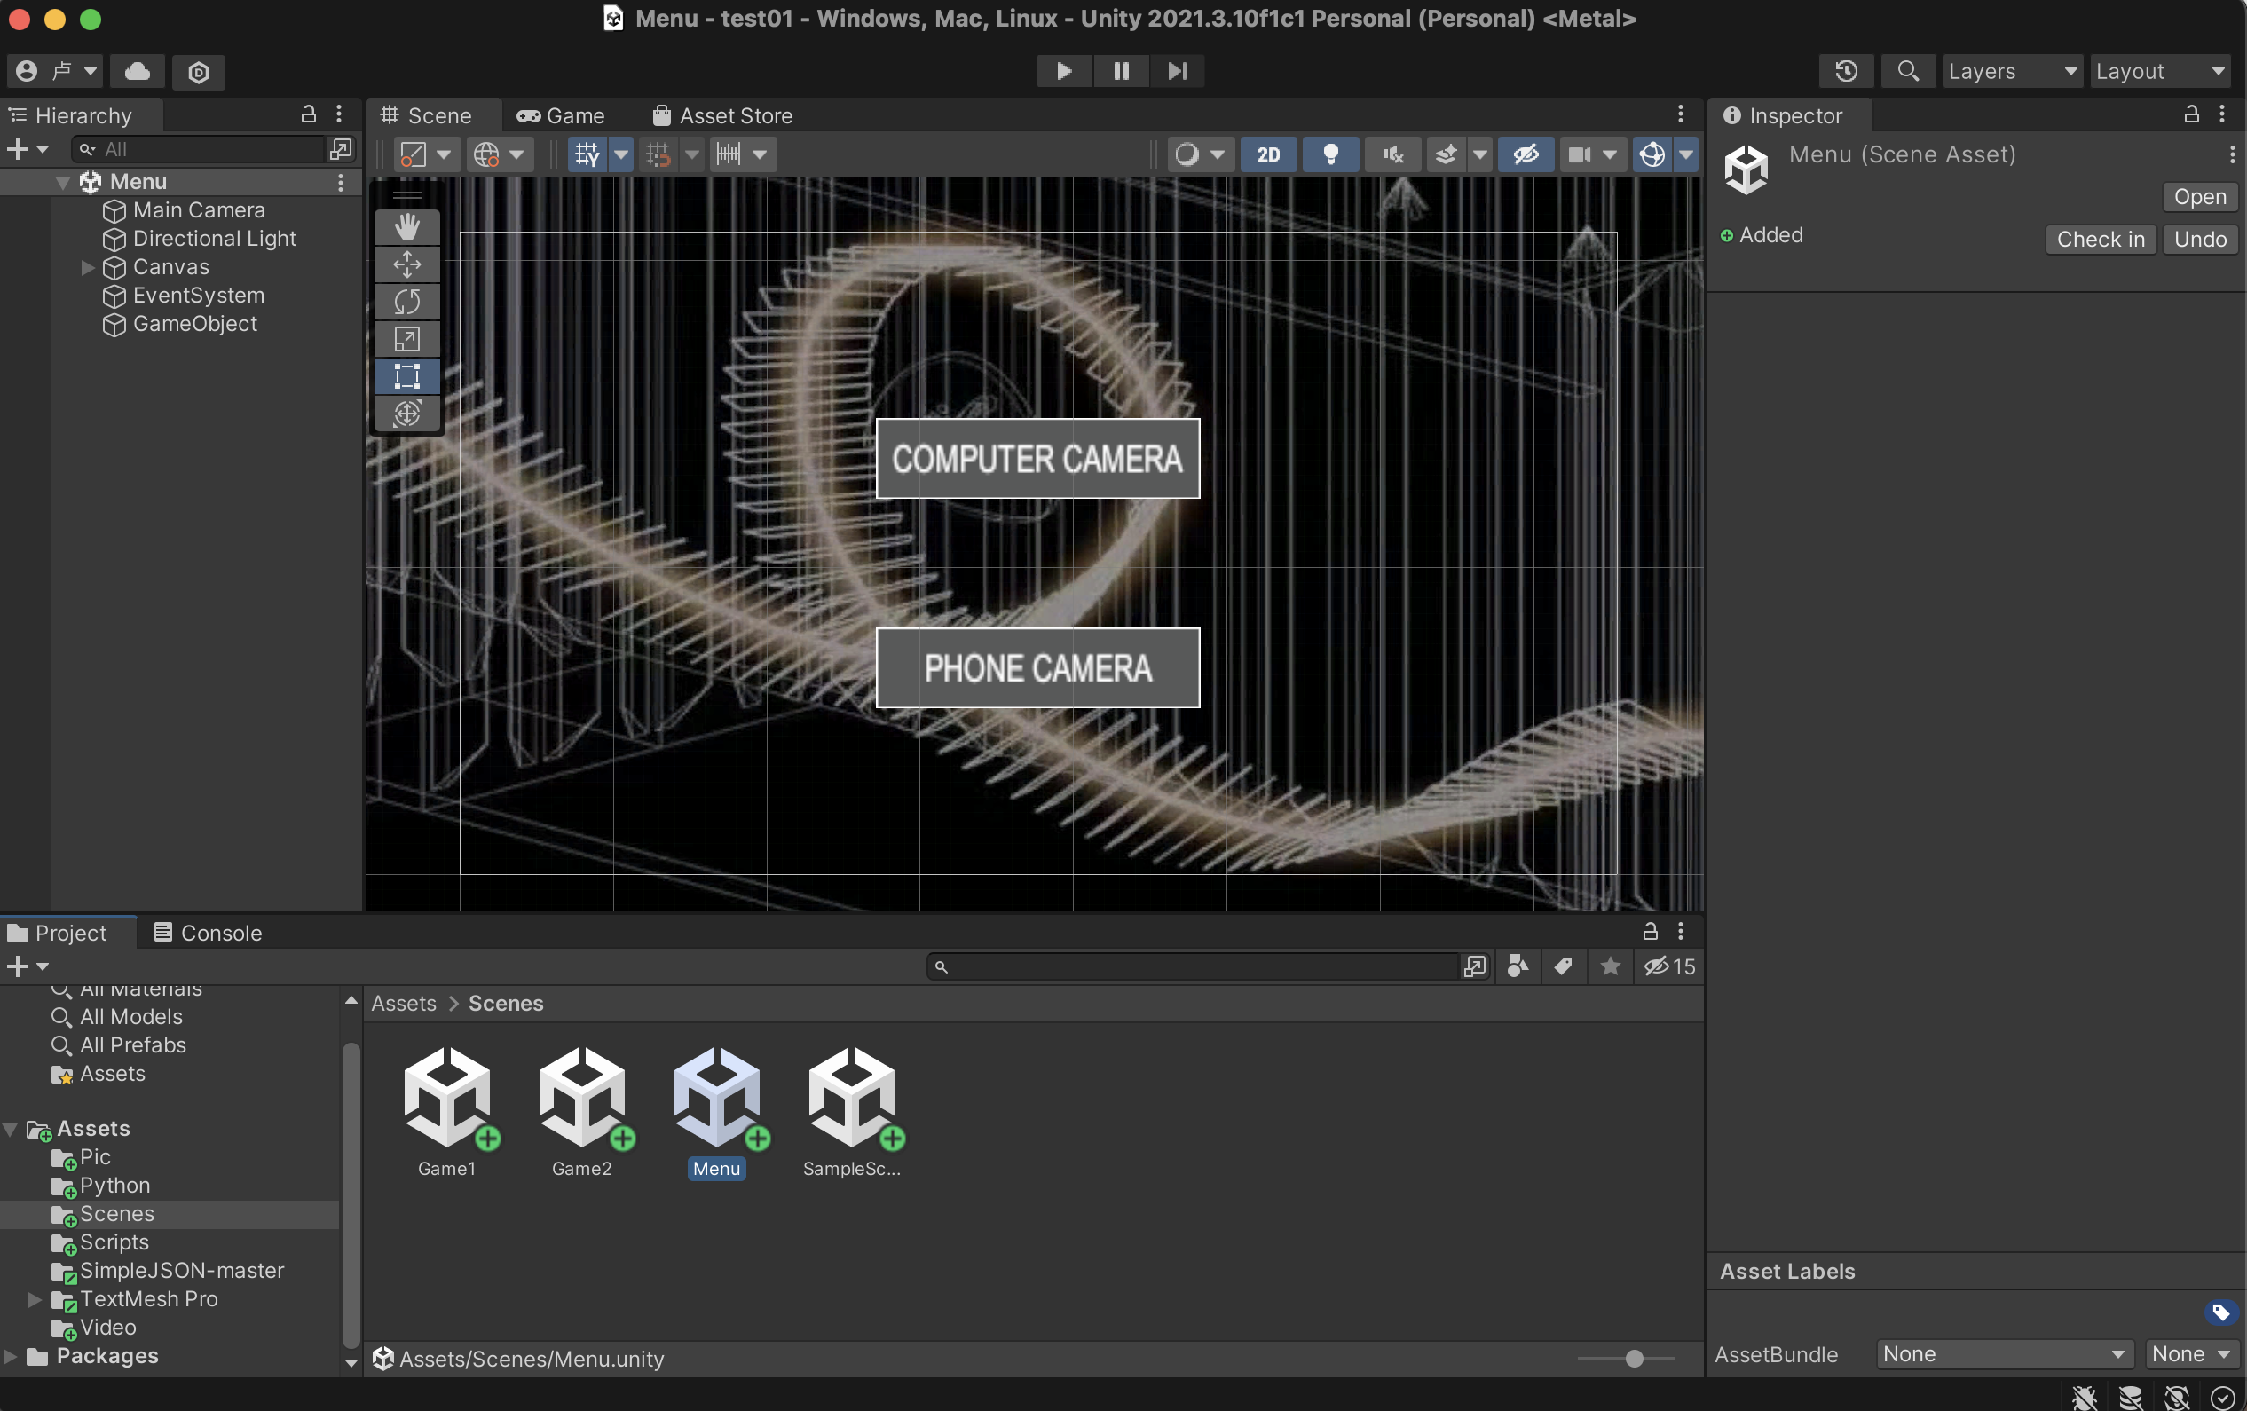
Front-end interface
The front end uses unity engine to produce, the main scenes include: initial interface, menu, function interface
The jump between scenes is realized by loadscene function in c# script. The main principle of UI design focuses on practicality and convenience

Slide 14
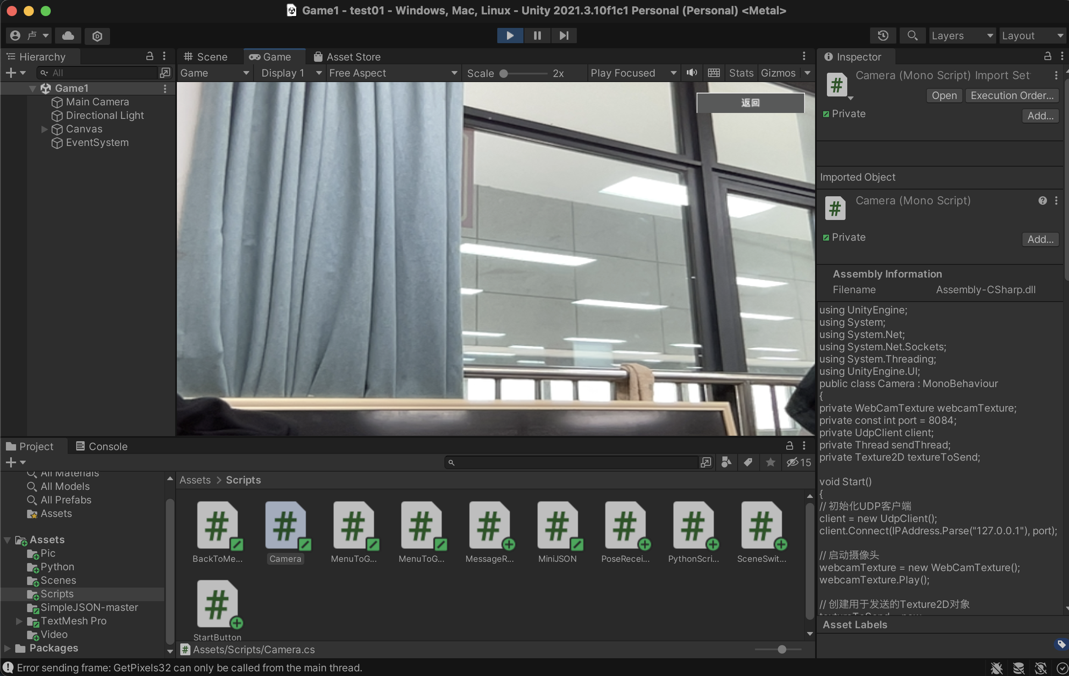
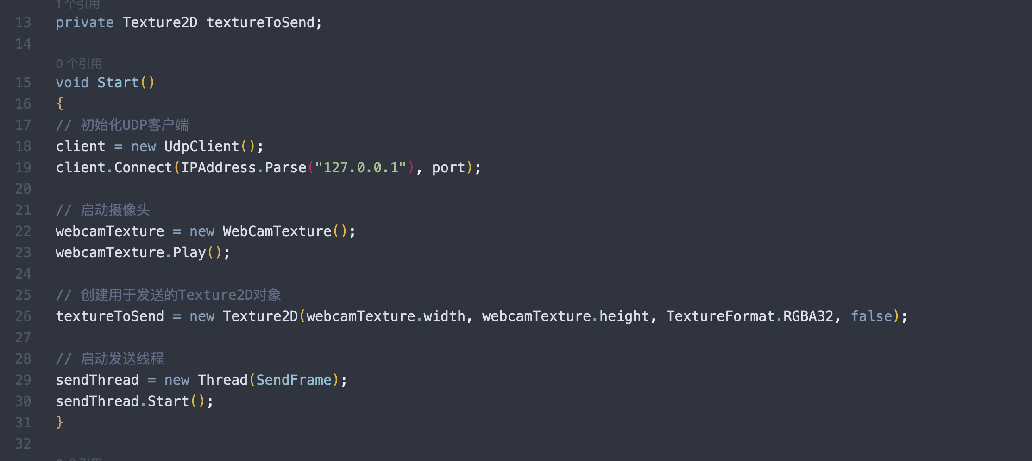
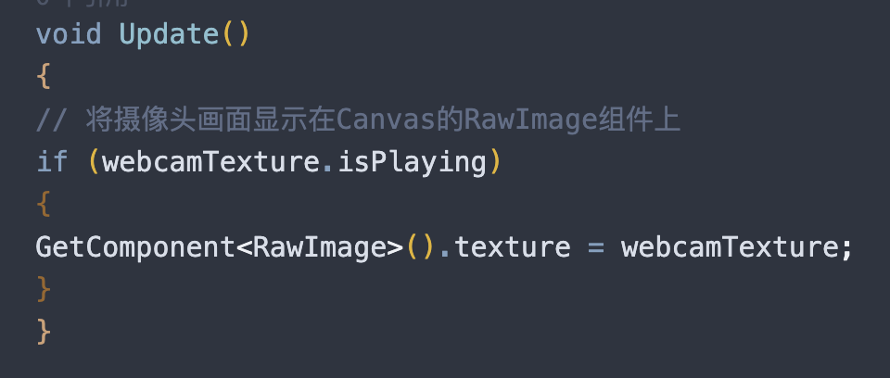
Front-end interface
The front end works by calling the computer camera through the c# script supported in the front end unity engine, and displaying the camera image on the RawImage component of the Canvas

Slide 15

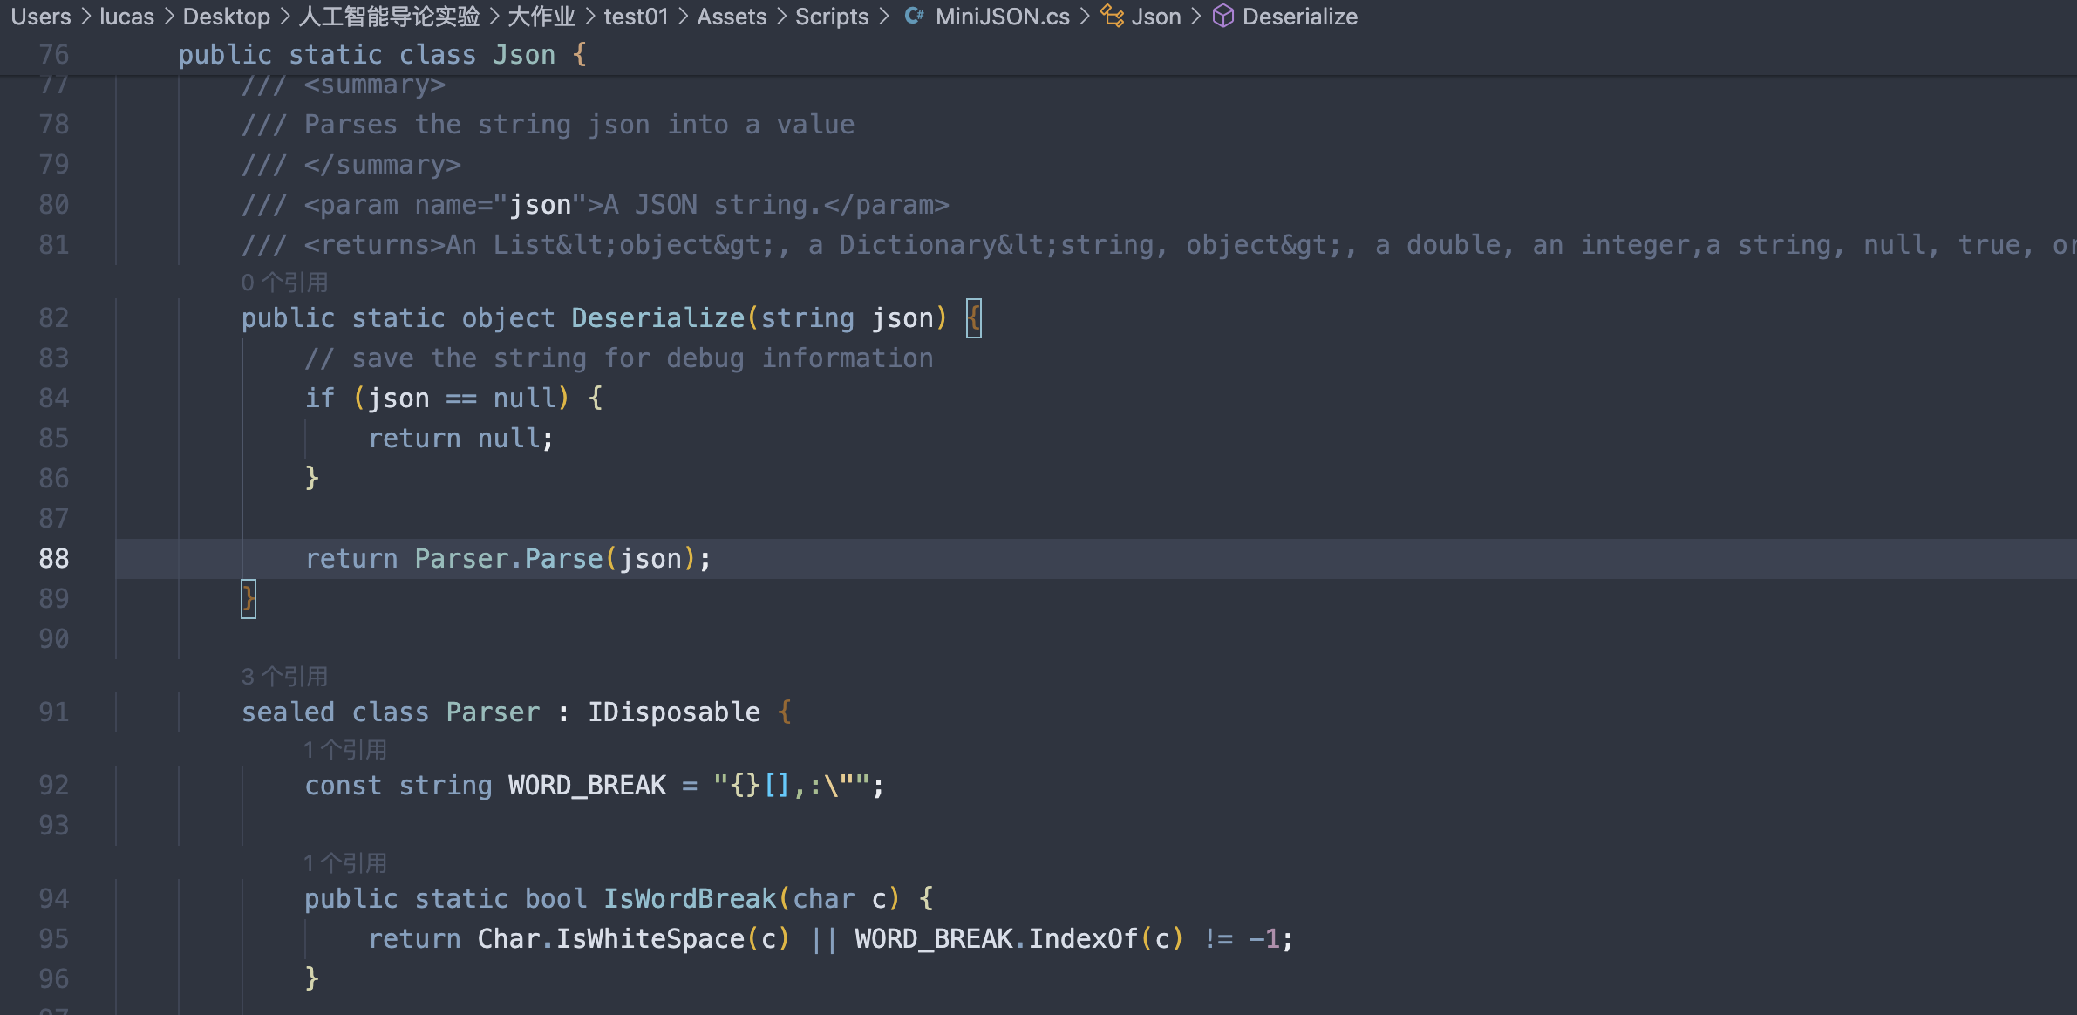
Front and Back End Connection

Slide 16

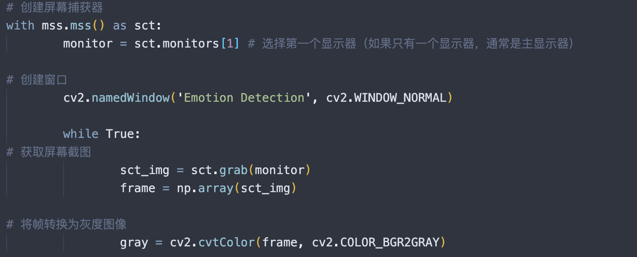
Front and Back End Connection
The working principle of the front and back end connection: using the mss library function of python, the front end calls the video stream video frame of the camera, processes each frame on the screen, obtains the screenshot from the screen, and displays it in the window in real time

Slide 17
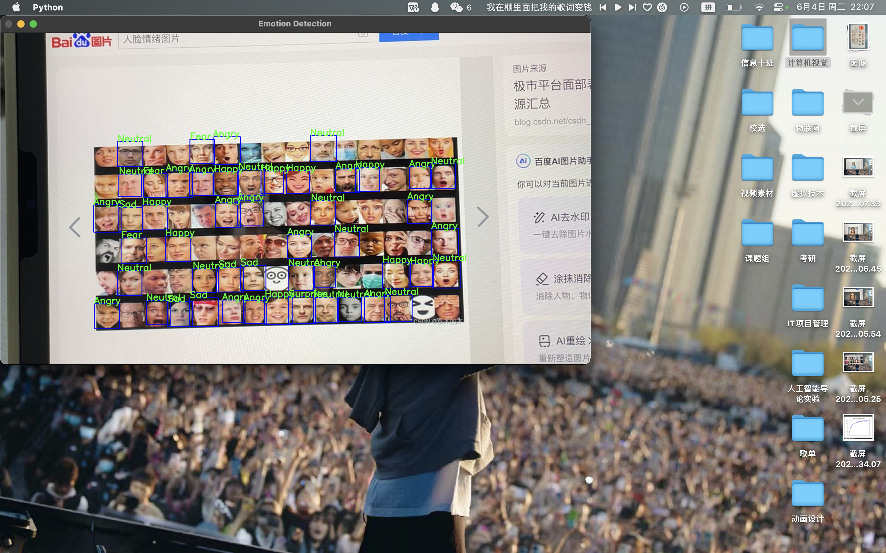




Run example

Slide 18

④
Research achievement

Slide 19
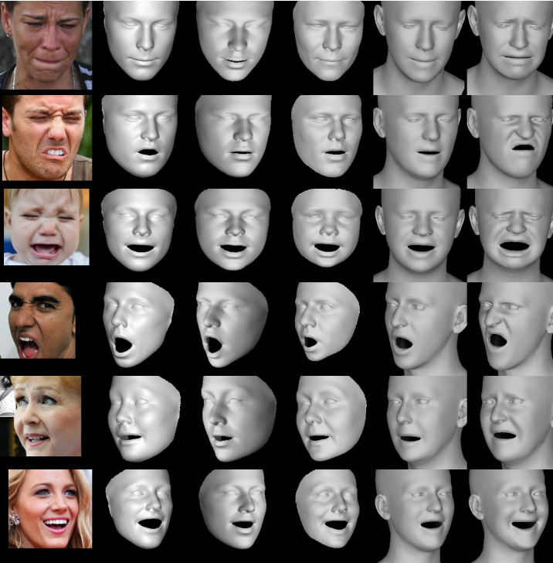
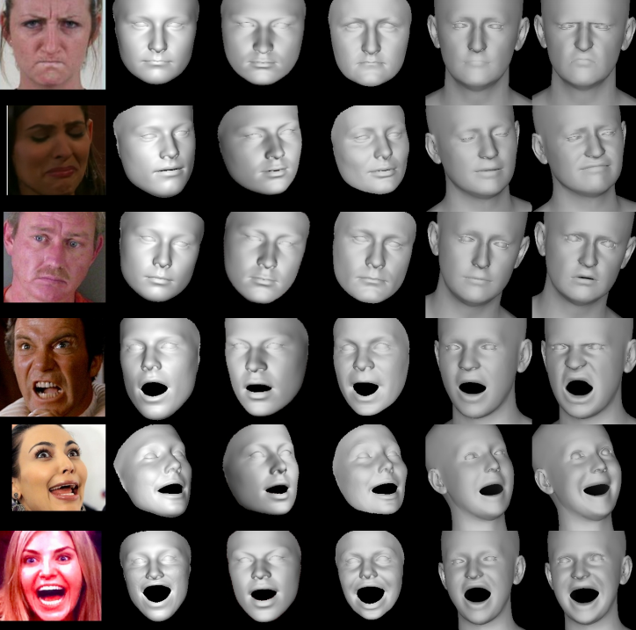
Research achievement
Picture processing

Slide 20
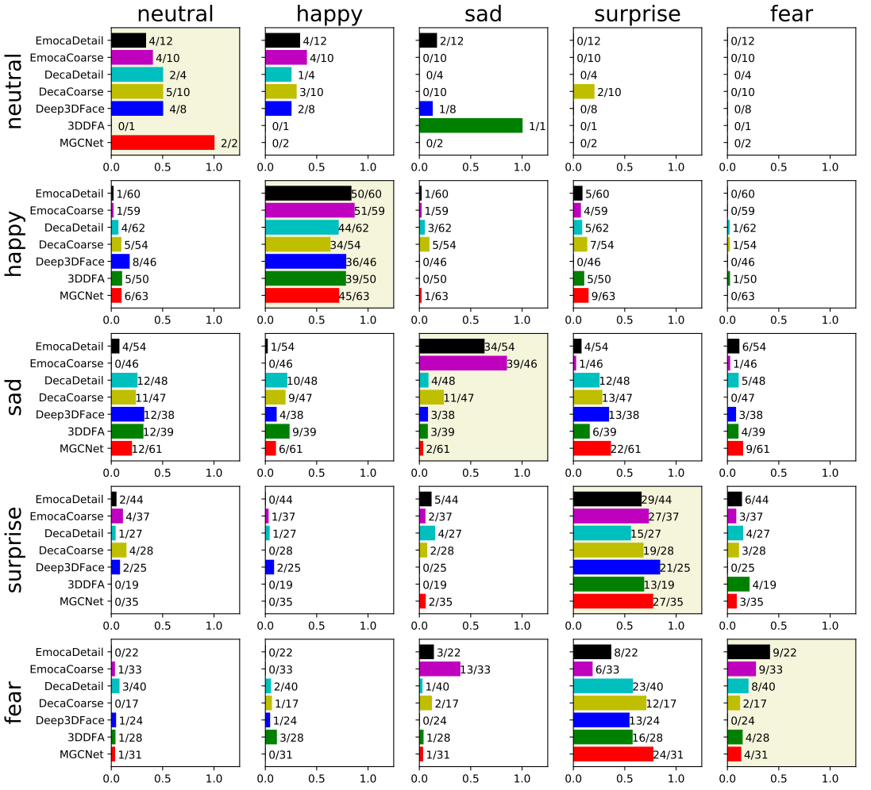
Research achievement
The figure shows the confusion matrix of different methods in the real image and the reconstructed image. The two variants of EMOCA (detail and roughness) outperform other methods in accuracy and show a lower degree of confusion on non-diagonal lines. Compared to other methods, EMOCA is better at distinguishing between different expressions, especially when it comes to fear, disgust, and anger. However, the reconstruction of distinguishing between disgust and anger remains challenging.

Slide 21
Thanks
Member：卢思宇、朱彦同、邵弈宁、孙康乐

